Slide 1
Using Bayesian Optimization in Pose Graphs Based SLAM 18th August
Zuxun Wang

Slide 2
Progress Since Last Meeting
Spot Bug
Test Linear system for two scenarios:
Scenario 1: Constant time intervals
Scenario 2: Vertices only when observations are taken
Test Linear system with stored simulator results
Performance Check using mean and covariance of graph

Slide 3
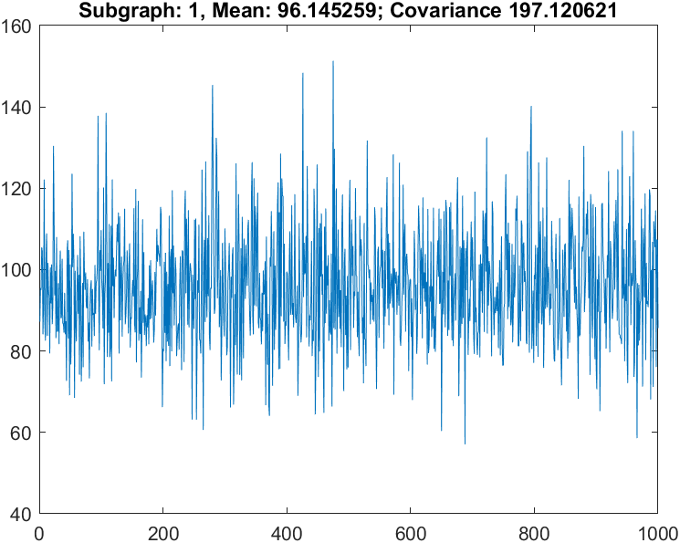
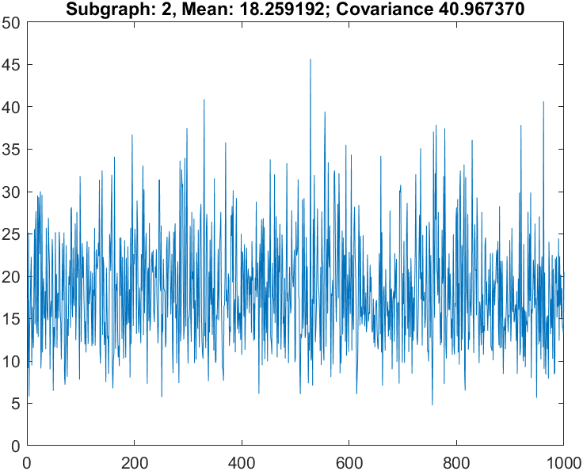
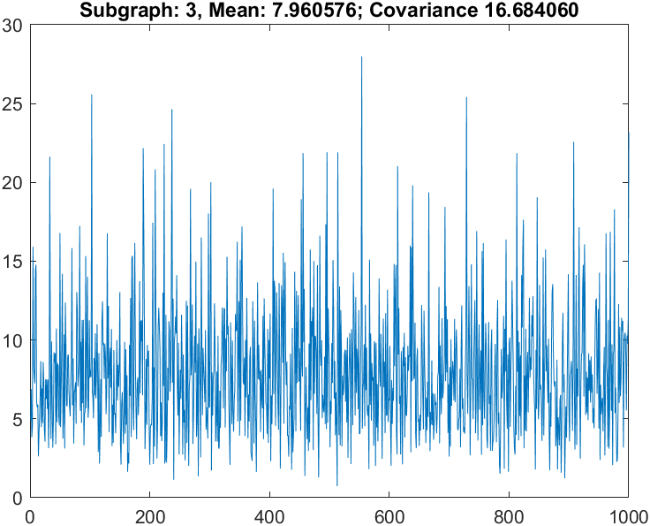
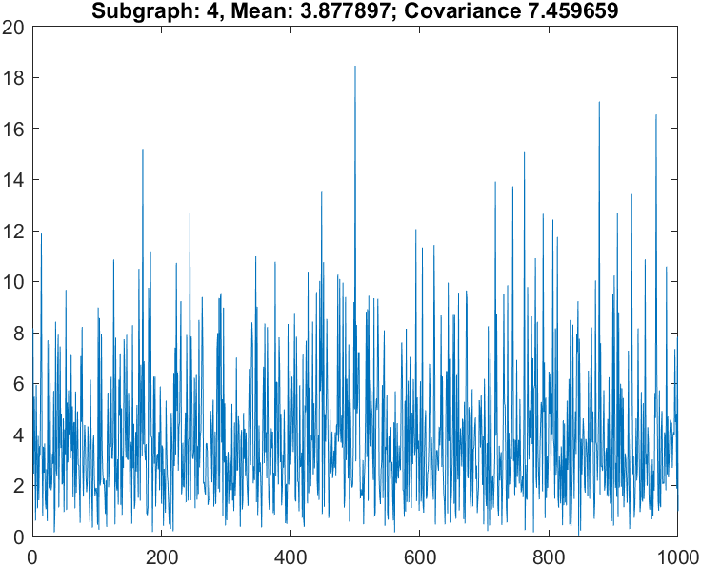
Linear System with Diff Simulated Results (Enable Prop4)
Total number of timestep: 200
Number of episodes: 1000
Num of subgraph: 4
numObs: 50
obsPeriod: [1 5 10 15]
Result CNIS Values for each subgraph using optimal Omega values:
[0.027832434017780,
0.143553835019665,
0.046805200597442,
0.100933193696296]

Slide 4
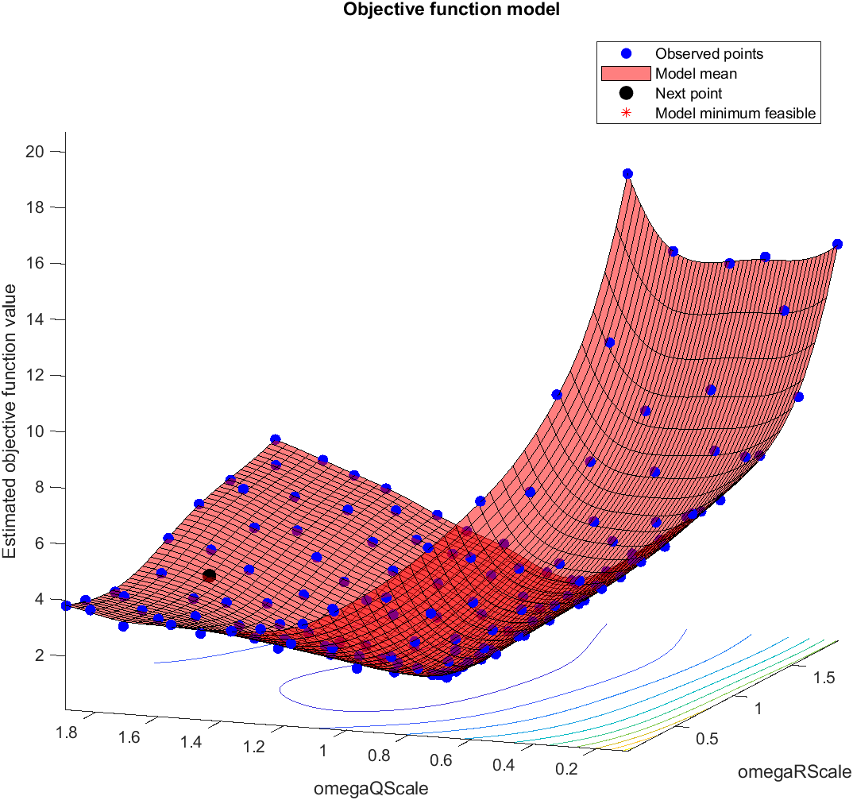
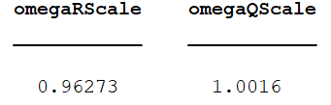
Linear BayesOpt Results (Scenario 1.1 - Prop4)
In this scenario, we use different simulated results.
And, for each subgraph, we lay down vertices at the same interval.
Total number of timestep: 200
Number of episodes: 1000
numObs: 50
obsPeriod: [1 5 10]
Cost Function: sum(C), where C stores CNIS value for each subgraph

Slide 5
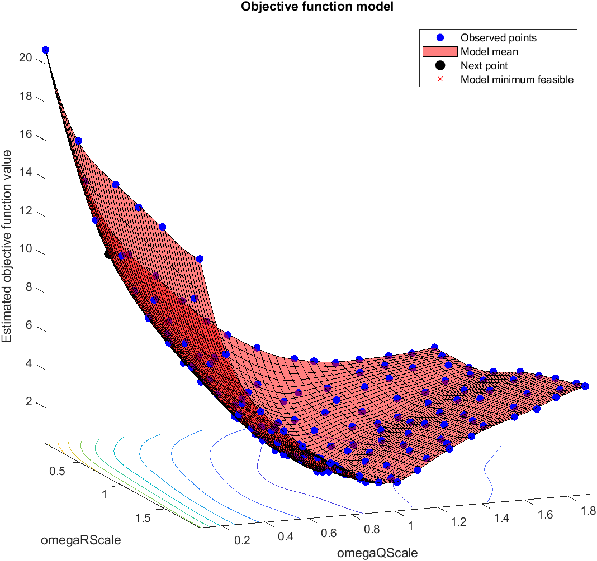
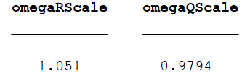
Linear BayesOpt Results (Scenario 1.2 - Prop4)
In this scenario, we use different simulated results.
And, for each subgraph, we lay down vertices only when observations are taken.
Total number of timestep: 200
Number of episodes: 1000
numObs: 50
obsPeriod: [1 5 10]
Cost Function: sum(C), where C stores CNIS value for each subgraph

Slide 6
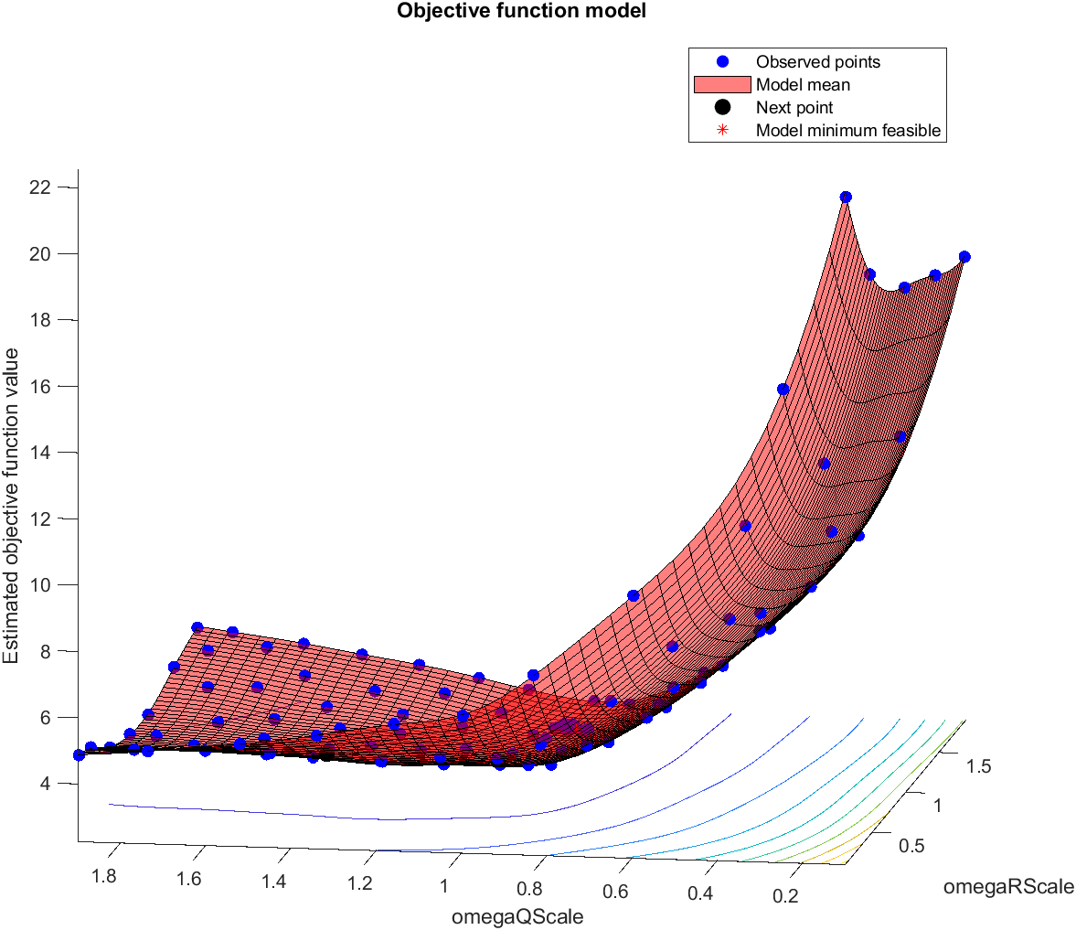
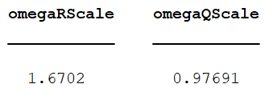
Linear BayesOpt Results (Scenario 1.1 - Prop4)
In this scenario, we use stored simulated results.
And, for each subgraph, we lay down vertices at the same interval.
Total number of timestep: 200
Number of episodes: 1000
numObs: 50
obsPeriod: [1 5 10]
Cost Function: sum(C), where C stores CNIS value for each subgraph

Slide 7
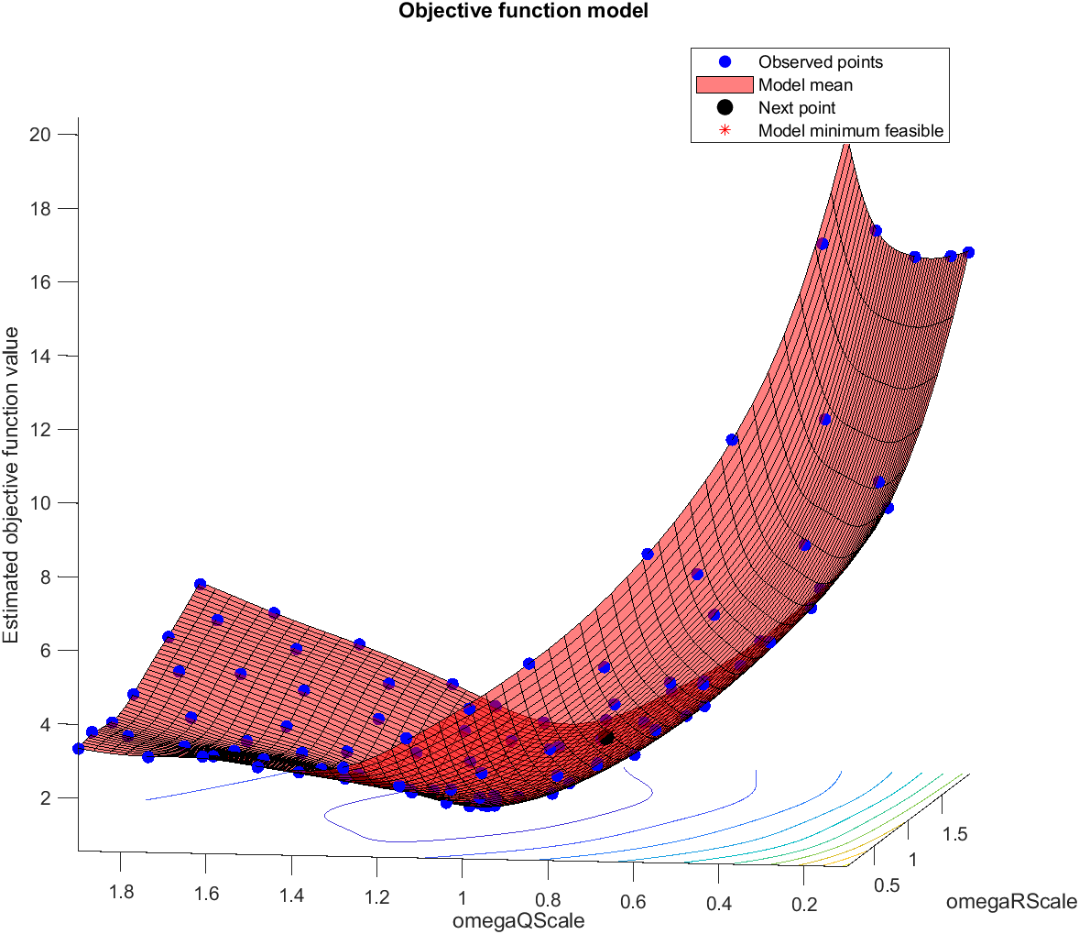
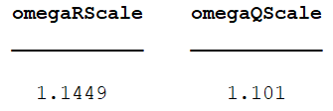
Linear BayesOpt Results (Scenario 1.2 - Prop4)
In this scenario, we use stored simulated results.
And, for each subgraph, we lay down vertices only when observations are taken.
Total number of timestep: 200
Number of episodes: 1000
numObs: 50
obsPeriod: [1 5 10]
Cost Function: sum(C), where C stores CNIS value for each subgraph

Slide 8
Brute Force Optimal Omega Values
Scenario 1.1 - Different Simulation
OmegaQScale: 1, OmegaRScale: 1, gives the minimum value
------------------------------------------------------------
Scenario 1.2 – Different Simulation
OmegaQScale: 1, OmegaRScale: 1, gives the minimum value
------------------------------------------------------------
Scenario 1.1 – Simulation Stored
OmegaQScale: 9.500000e-01, OmegaRScale: 1.150000e+00, gives the minimum value
------------------------------------------------------------
Scenario 1.2 – Simulation Stored
OmegaQScale: 9.000000e-01, OmegaRScale: 1.200000e+00, gives the minimum value
------------------------------------------------------------

Slide 9
Performance Check
X and Px line numbers do not match
X line number: 260
Px line number: 685
------------------------------------------------------------
File name: frob_results.txt
Line number with min mean value: 260
OmegaQScale: 0.10, OmegaRScale: 0.45, gives the minimum value, which is 1973.610692
------------------------------------------------------------
Line number with min covariance value: 685
OmegaQScale: 1.05, OmegaRScale: 1.00, gives the minimum value, which is 0.359795
OmegaQScale: 0.10
OmegaRScale: 0.45
X_Frob: 1973.610692, Px_Frob: 55.386518
OmegaQScale: 1.05
OmegaRScale: 1.00
X_Frob: 20016.533032, Px_Frob: 0.359795

Slide 10
Problems / Issues

Slide 11
Planned Activities
Implement both scenarios for GPS System?
Fix interval length is fine
Heatmap to better illustration of area that we interested.
Check the state value for each timestep in linear scenario.
For each timestep k, compute and plot (x_k – x_k_truth), similarly for xdot, y and ydot.
For covariance, only plot the diagonal terms.
AES paper 2D tracking example, try with 2 dof case.

